Slide 1
Importance of Sukuk
For
Islamic Financial Industry
Mr. ASIM HAMEED
26 July 2022

Slide 2
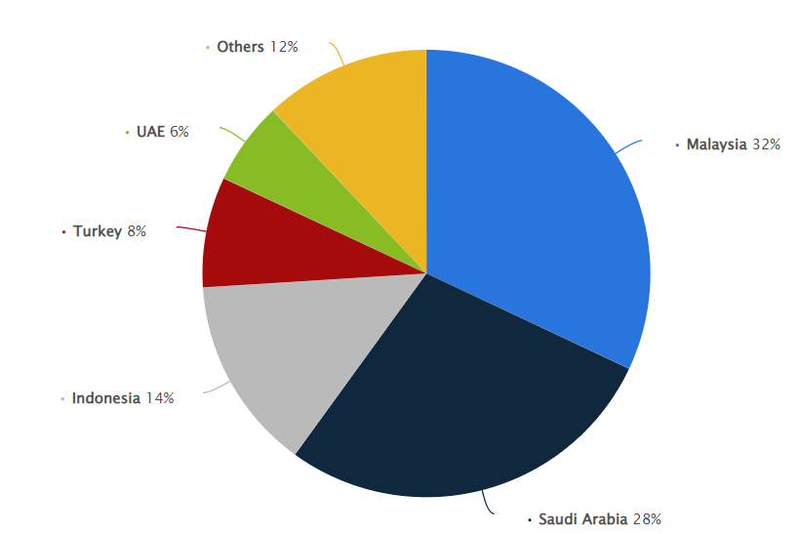
Executive Summary
Sukuk are the paper which represents the ownership in the assets (assets based) – its an Islamic alternative of interest-bearing bonds.
From total Sukuk issued globally, 53% were Sovereign Sukuk issued by Corporates 37% and others 1%.
Islamic Financial Industry highly need Sukuk. It provides a great opportunity to issuer for fund raising for specific purposes, simultaneously provides better returns options to investors. Also, such instruments are useful product structuring in various areas such as liquidity management, SMR, OMO, Inter-back, special rates to depositors and many other activities can be done through Sukuk.
Issuer Types: Corporate Sukuk, Sovereign, Financial Institutions, Quasi- Sovereign.
Global outstanding Sukuk US$ 723 Bn at end-1Q22.
In 2021, more than US$ 185 Bn worth of issuance over the course of the 12 months.
The global market of Sukuk is expected to reach by US$ 2,000 Bn by end of 2027 exhibiting CAGR of 17%.
As per recent statics, the Sovereign Sukuk distribution worldwide led by Malaysia up to 32% Sukuk in 2020.
1

Slide 3
Sukuk Landscape of Tanzania
Imaan finance Limited has issued three private sukuks. Below are the details of the previous sukuk issuances;
Imaan Finance Limited was incorporated as a private company limited by shares on 24th October 2013 under the Companies Act 2002 and licensed by BOT under Tier 2 in 2021. The Company’s core activities include offering financing to SME, Corporate and individuals in compliance with Sharia Principles to promote economic development & growth and generating more employment.
Many other Financial Institutions and FMCGs are coming up with Sukuk (in pipeline).
We foresee, 2023 will be a game changer in Sukuk market of Tanzania.
2

Slide 4
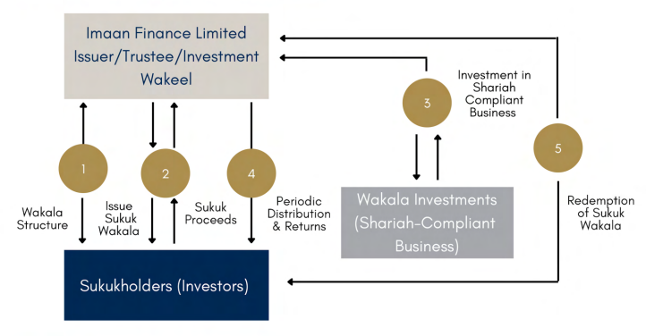
Sukuk Al Wakala of Tanzania
Al Wakala Bi Al Istismar is the investment agency contract. Whereby Sukukholders appoints an agent to act on behalf of them to invest their funds into the pool of assets of Shariah Compliant business to generate profit for them.
Investment Agent act in the favour of the Sukukholders and places funds in profitable and permitted ventures/financings.
Targeted Expected profit is set for Sukukholders and any profit over and above the Targeted Expected profit is given to Investment Agent as an incentive in addition to a fixed agency fee of nominal amount.
5

Slide 5
Way Forward
Awareness Programs for Issuers, Investors, regulatory bodies, legal & advisory firms
Shariah Committees: Pool of Experienced Professionals (local & foreign)
Sukuk Governance Framework: Regulations, Guidelines, Instructions
Develop retail market for Sukuk consumption & encourage individual investors
Promote corporate entity for issuance of Sukuk being asset backed and more secure in nature
Promote issuance of Sovereign Sukuk
Bring innovation in structuring, simplification, minimum documentation
Utilizing technology for sukuk issuance such as smart contracts, block chain, ease of investments tools by individuals
Creating secondary market for sukuk trading (OTC market) to promote Sukuk trading and enhancing listing regulations for Sukuk.
5

Slide 6
THANK YOU

